Slide 1

Introduction to ML
Dinesh Babu J

Slide 2
Big picture
AI problems
ML solution
ML paradigm - Supervised, Unsupervised, Reinforcement learning
Supervised - Regression, Classification
Task
Dataset
Features
Models
Algorithms - Learning and Inference

Slide 3
Predictive Analytics problems e.g.
Spam detection prediction
Input: email ; Output = Spam or not
Score prediction (out of 100) in ML Course
Input: 10,12 math marks; Output = Predicted Score
News article group prediction
Input: Set of news articles; Output = Cluster ID
Output
System/
Algo
Input
Notes:
Consider the spam detection problem relevant for a email client – Label an email as spam or not
Next, consider an even more interesting problem, an unsolved problem as of now…..
Finally, the problem of grouping a new article into various categories – think of google news..
Those are Predictive Analytics problems …Fine..how can we solve using Machine Learning?

Slide 4
Solving predictive analytics problems using Machine Learning…
What is Machine Learning?
“Systematic study of algorithms and systems that improve their knowledge or performance with experience on certain tasks” [Prof. Tom Mitchell, CMU]
In a Machine Learning framework, Predictive Analytics problems (Spam detection; ML Score prediction; News article grouping) become tasks
Experience is in the form of data, say past data
Performance: how well does the algorithm predict..
Notes:
First, what is ML?...PA problems becomes tasks, and the experience can be in the form of data, say past data..
and performance can be measured by seeing how well the algorithm predicts..

Slide 5
How To build an ML algorithm
The previous viewpoint was a requirement viewpoint
Let us take the engineering viewpoint i.e. how to build an Machine Learning System
Machine learning formulation consists of “tasks, dataset, features, and models”
To start: Pose a suitable task, Collect a good dataset, Extract relevant features
To solve: Choose a model to implement, Learn a model using the dataset (learning algorithm) , use the model to predict (inference algorithm)
Notes:
As we have for our Predictive Analytics problems
the task, experience and performance measure, we can use ML algorithms..that is the requirement viewpoint..
let us take the …
What do we need? Tasks, Models, Features and Datasets…To start concretely we will pose a suitable task, collect a good dataset, extract
Relevant features; and to solve, we will choose a model to implement and learn a model tapping the knowledge from the data

Slide 6
How do build a ML algorithm
The previous viewpoint was a requirement viewpoint
Let us take an engineering viewpoint of Machine Learning
Machine learning consists of “tasks, models, features, and datasets”
To start: Pose a suitable task, Collect a good dataset, Extract relevant features
To solve: Choose a model to implement, Learn a model using the dataset (learning algorithm), use the model to predict (inference algorithm)
…Let’s get started
Notes:
To start let us pose a suitable task, collect a good dataset, and extract relevant features…

Slide 7

Inference using ML
Output
MALE/FEMALE
ML
Algo
What is this ML algorithm?
How do we build this algo?
Feature
Hair length
Feature extraction
Input
Image

Slide 8
Inference using ML
Output
MALE/FEMALE
ML
Algo
What is this ML algorithm
How do we build this algo?
Feature
Hair length
Feature
Pitch
Feature extraction
Feature extraction
Input
Image
Input
Voice

Slide 9
Predictive Analytics problems e.g.
Spam detection prediction
Input: email ; Output = Spam or not
Score prediction (out of 100) in ML Course
Input: 10,12 math marks; Output = Predicted Score
News article group prediction
Input: Set of news articles; Output = Cluster ID
Output
ML
Algo
Feature
Feature extraction
Input
Notes:
Consider the spam detection problem relevant for a email client – Label an email as spam or not
Next, consider an even more interesting problem, an unsolved problem as of now…..
Finally, the problem of grouping a new article into various categories – think of google news..
Those are Predictive Analytics problems …Fine..how can we solve using Machine Learning?

Slide 10
Spam detection problem
TASK, DATASET, FEATURES
Task – Classification {SPAM(+1), HAM(-1)}
Dataset – {Emails, SPAM/HAM Label}
Gmail: User flagging
Features – {x₁, x₂…} e.g. frequency of occurrence of certain words (LOTTERY – 10; VIAGRA – 8..)
Past Email
features
Answers: SPAM/HAM
Learning
Algorithm
Model
New Email
features
Question: SPAM/HAM
Inference
Algorithm
Notes:
Spam detection problem is a classification task, in fact a binary classification task, with only two possible output classes
Past knowledge could come from labeled emails, emails which are marked as Spam or not..
Of course, we need to preprocess the data and represent every email in a suitable representation
which is the feature extraction process. For example..
With the past email features, and the labels as in a email is SPAM or HAM,
the learning algorithm will learn a model..
The Inference algorithm uses the model to predict if an email is spam or not
after seeing the features of a new email…

Slide 11
ML Score prediction problem
TASK, DATASET, FEATURES
Task – Regression [0, 100]
Dataset – {10th 12th Math score, ML score}
Questionnaire to past students
Features – {x₁, x₂} e.g. {75, 80}
Past students
Math marks
Learning
Algorithm
Answers: ML score
Model
New student’s
Math marks
Inference
Algorithm
Question: ML score?

Slide 12
Credit:
Prof. Srihari

Slide 13
News item grouping problem
TASK, DATASET, FEATURES
Predictive Clustering task:
Assign one of {1, 2, ….K} to a news article
Dataset – set of news articles
Query Google with “news”
Features – {x₁, x₂, x₃, x₄} e.g. {topic distributions}
Features from
collection of
news items
Learning
Algorithm
Cluster IDs for
every news item
Model
New article
features
Inference
Algorithm
Which Cluster
Is best suited?
Notes:
News item grouping problem is a predictive clustering task
Where we want to group news articles into semantically
Meaningful categories let us say K categories..
To get started we need a dataset which is a collection of news articles,
Say we query Google with news
From this if we obtain features that capture the topic distributions
(say percentage of sports, education etc), then
our learning algorithm can cluster these news items according to the
Topics. Given a new article we can assign the best suited cluster.

Slide 14
How do build a ML algorithm
The previous viewpoint was a requirement viewpoint
Let us take an engineering viewpoint of Machine Learning
Machine learning consists of “tasks, models, features, and datasets”
To start: Pose a suitable task, Collect a good dataset, Extract relevant features
To solve: Choose a model to implement, Learn a model using the dataset (learning algorithm), use the model to predict (inference algorithm)
…Let’s solve
Notes:
So far our learning algorithm has been a black box, we talked about
how to pose the problem – with the discussion on task, dataset and
Features..
Now let us come to solving the ML problem..
Need to choose a model, and
then to choose a learning algorithm to
Implement
ML Theory – helps us to understand
The pros and cons of using different
Models and learning algorithms

Slide 15
Solution 1: Classification problem
MODEL, LEARNING, INFERENCE ALGORITHM
e.g. Spam detection problem
Models: straight line to divide (a linear model)
Past Emails
Answers: Spam or not
Learning
Algorithm
x₂
x₂
x₁
x₁
Notes:
Now let us make this less abstract with examples..
One possible model for the classification problem
Is a straight line separator to divide the different
Classes.
Couple of learning algorithms are perceptron and
Support Vector Machines (SVM)..The learning
Algorithm learns the parameters of the st. line
i.E slope and the intercept.
Given a new point see which side of the line the
Point belongs to and then decide the class label..

Slide 16
Solution 2: Regression problem
MODEL, LEARNING, INFERENCE ALGORITHM
e.g ML1 Score prediction problem
Models: straight line to fit the data
Past students
10 th Maths
marks
Answers: ML1 score?
Learning
Algorithm
y
y
x₁
x₁
Notes:
Coming to the regression problem i.e. PA score prediction..
a possible model is a straight line to fit the given data..
Contrast this with the classification case where the
Goal was to classify the two classes..
Here we want to fit a straight line through the data..
One possible solution is linear regression..and the
Case of univariate..this is the least squares fitting
We would have come across in high school.

Slide 17
Solution 3: Clustering problem
MODEL, LEARNING, INFERENCE ALGORITHM
e.g. News grouping problem
Model: distance based
Collection of
news items
Cluster IDs for
every news item
Learning
Algorithm
x₂
x₂
x₁
x₁
Notes:
For the clustering problem, let us look at a distance based model..
Where we choose cluster centers, and then assign the cluster
Label based on distance from the cluster centers
Note in this case the circles were not colored to begin with
Unlike the classification problem. In this context the learning
Algorithm is unsupervised…

Slide 18
Evaluation metric: Classification problem
How do we know the solution on the right is better than the left?
Total misclassifications (left) = 2
Total misclassifications (right) = 0; so right is better
x₂
x₂
x₁
x₁
Notes:
Let us also talk about Evaluation metric, which will help us choose
which parameters are best, and which model is better say a linear
Model or a quadratic model for example
For the classification case, how do we know…

Slide 19
Evaluation metric: Regression problem
$$ypred_{i}=mx_{i}+b$$
$$∑(y_{i}-ypred_{i})^{2}$$
y
y
ypred_{i}
ypred_{i}
y_{i}
y_{i}
x
x
x_{i}
x_{i}
Notes:
As regards the regression problem,
m and c are the parameters of the model i.e. decides a straight line,
and given two possible straight lines the one that leads to the
Least squared error is what we will choose..
Compared to the line on the left, the right line leads to
Smaller sum of squared error corresponding to the expression shown..

Slide 20
ML experiments
Training
Features
Learning
Algorithm
Training
Labels
Model
Test
Features
Inference
Algorithm
Predicted Labels
Predicted Labels
e.g. Accuracy
Evaluation
Algorithm
Test Labels
Notes:
Now we can structure the ML experiments in the following way
learning algorithm uses the training data to come up with a model
The inference algorithm uses the model to make label predictions
On the test data
The evaluation algorithm checks how good is the predictions..

Slide 21
Revisit: solving the predictive analytics problem
Machine learning consists of “tasks, models, features, and datasets”
To start: Pose a suitable task, Collect a good dataset, Extract relevant features
To solve: Choose a model to implement, Learn a model using the dataset
Search the space of model parameters and optimise the error measure; e.g. find the best line that minimises the classification error
Notes:
Let us summarize what we have done so far..
We said ML consists of …
To start, given a predictive analytics problem.. We pose a..
To solve, we
What this actually involves, which is the core of this course is to
Search..
Now let us discuss..

Slide 22
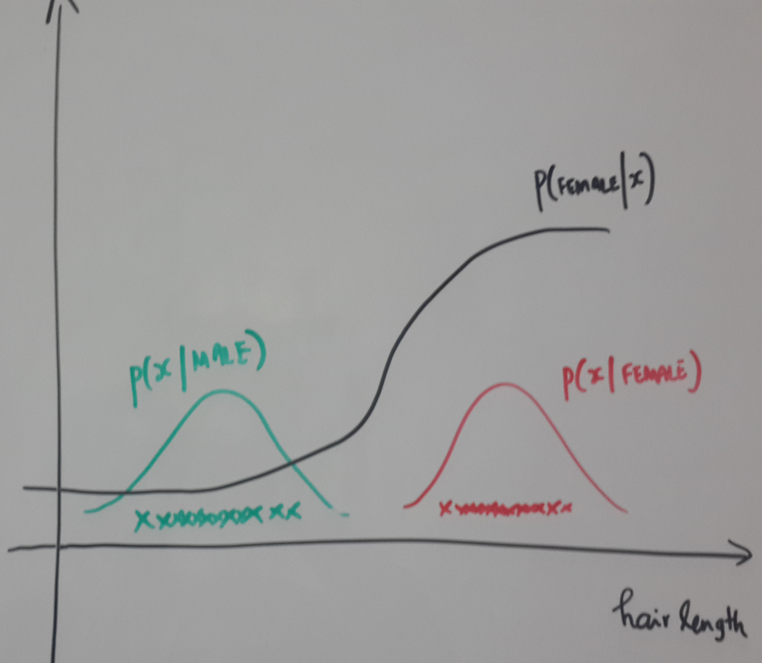
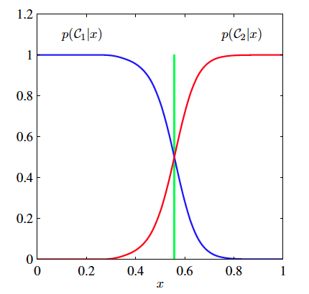
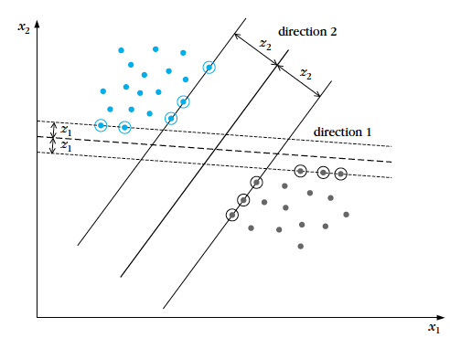
Models and model parameters
Support Vector
Machine
Bayes Classifer
Logistic regression

Slide 23
Revisit: solving the predictive analytics problem
Machine learning consists of “tasks, models, features, and datasets”
To start: Pose a suitable task, Collect a good dataset, Extract relevant features
To solve: Choose a model to implement, Learn a model using the dataset
Search the space of model parameters and optimise the error measure; e.g. find the best line that minimises the classification error
Notes:
Let us summarize what we have done so far..
We said ML consists of …
To start, given a predictive analytics problem.. We pose a..
To solve, we
What this actually involves, which is the core of this course is to
Search..
Now let us discuss..

Slide 24
Optimization methods
Unconstrained Minimisation

Slide 25
Optimization methods
Unconstrained Minimisation

Slide 26
Optimization methods
Constrained
Minimisation

Slide 27
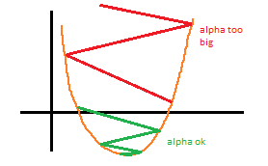
Optimization methods
Global vs local optimum
- Neural networks
Single optimum
- SVM

Slide 28
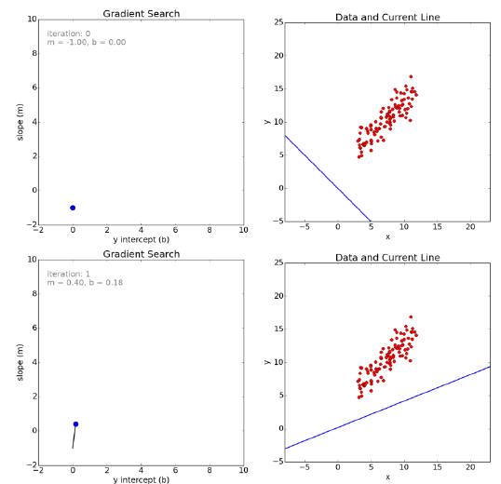
MODEL
SPACE
DATA
SPACE
$$ypred_{i}=mx_{i}+b$$
$$L(m,b)=∑(y_{i}-ypred_{i})^{2}$$
Notes:
After several iterations, we can see that we reach the minima,
and the corresponding model parameters fit the given the data
points the best.

Slide 29
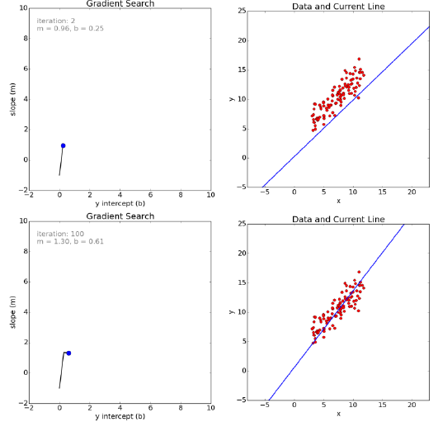
MODEL
SPACE
DATA
SPACE

Slide 30
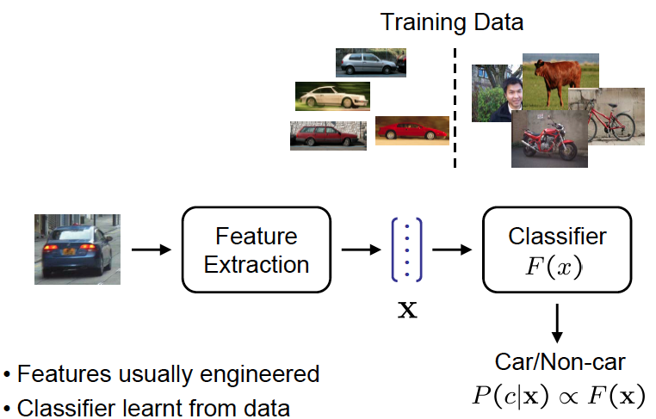
Car Recognition
SLIDE CREDIT:
ANDREW ZISSERMAN

Slide 31
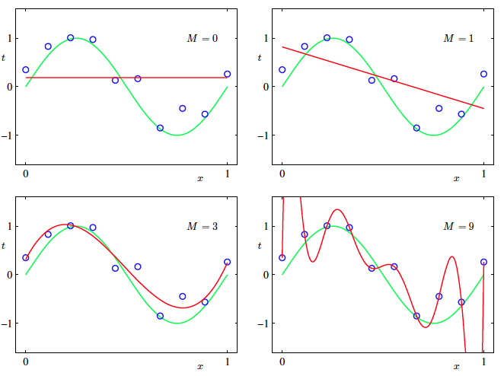
Regularization: Overfitting
Are linear
models enough?
NO..

Slide 32
Supervised vs Unsupervised learning
Supervised
Regression - Score prediction
Binary Classification - Spam detection (SPAM/HAM)
Multiclass classification - (SPAM/NORMAL/URGENT)
Unsupervised
News item clustering
No categorization or scoring – to begin with
Notes:
First, let us talk about the difference between Supervised and
Unsupervised learning tasks..
Regression and Classification are supervised problems as we
have a label in both cases for training.
As regards Regression, the output label is a continuous score
Where as classification output label is categorical, say SPAM vs HAM..
In this case this is a binary classification task, and when we have more
than two categories we call multiclass classification task
An example of unsupervised learning task is the clustering task..
Where we do not have a label to begin with..

Slide 33
Conclusion
Machine learning formulation consists of “tasks, dataset, features, and models”
To start: Pose a suitable task, Collect a good dataset, Extract relevant features
To solve: Choose a model to implement, Learn a model using the dataset (learning algorithm) , use the model to predict (inference algorithm)
Examples of models
Learning algorithm – uses optimisation methods
Notes:
As we have for our Predictive Analytics problems
the task, experience and performance measure, we can use ML algorithms..that is the requirement viewpoint..
let us take the …
What do we need? Tasks, Models, Features and Datasets…To start concretely we will pose a suitable task, collect a good dataset, extract
Relevant features; and to solve, we will choose a model to implement and learn a model tapping the knowledge from the data

Slide 34
Data Collection
Characteristics of a good dataset
MORE DATA
DIVERSE DATA
Why DIVERSE DATA?
Consider the problem of recognizing a “Maruti car”, if your training data consists of only white Maruti, then don’t be surprised if your model does not recognize a “red Maruti car”
Notes:
The next aspect is Data Collection..
What are the characteristics..
Of course more data is useful, as learning will be more robust..
More importantly the data should be diverse..

Slide 35
Feature extraction
Consider Spam recognition problem
Email
Feature extraction
Email Features:
Histogram of key words
Past Email
features
Spam or not
Learning
Algorithm
Spam or not?
New Email
features
Model
Notes:
Next let us briefly talk about feature extraction ..
For our spam recognition problem given a email
we first extracted the histogram of key words..this
is the feature extraction step where we obtain a
suitable representation to build a model..
Our hypothesis is that whether a mail is spam or not
Depends on how often certain words occur.. and to
Put it simply, in a spam “bad words as in viagra or
lottery” occur more often than in a normal email.

Slide 36
Feature extraction
Consider Spam recognition problem
Features should be relevant
Same set of features may not work for another task say “classifying a email is grammatically correct”
Email
Feature extraction
Email Features:
Histogram of key words
Notes:
An important point to remember is the features should be
Relevant. One set of features useful for a certain task
need not be good for another task. For example
The histogram of key words may not be a good
Feature to say if a word is grammatically correct,
As a jumbled up sentence and a correct sentence
Might have the same feature representation..

Slide 37
Simple prediction problem
Infer: Given Hair length = 6 cm, MALE or FEMALE
Infer: Given Hair length = 30 cm, MALE or FEMALE

Slide 38
RuleS
Output
MALE/FEMALE
Threshold = 15 cm; given by an expert
If (Hair length < Threshold)
Then MALE
Else FEMALE
Hand
designed
rules
Input
Hair length

Slide 39
ALTERNATE APPROACH
Give hair length data of 50 MALE, 50 FEMALE
Let a program learn the threshold
(OR) Let a program decide how to use hair length and decide

Slide 40
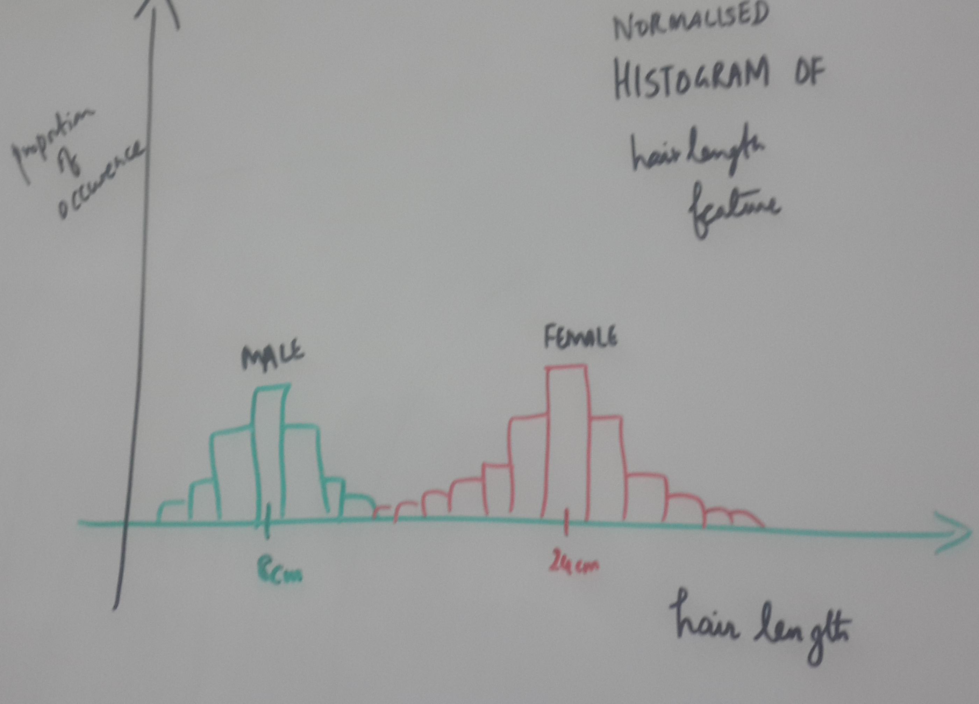
Inference using ML
Output
MALE/FEMALE
ML
Algo
What is this ML algorithm?
How do we build this algo?
Input
Hair length

Slide 41
PROBLEM: AI/Predictive Analytics problems SOLUTION: USING ML
Role of Machine Learning?
One way of building such a AI/PA system or algorithm
Learn from past data automatically
Powerful way of doing so, unlike rules which can break easily
{Sound theory, powerful algorithms and insights}
Output
System/
Algo
Input
Notes:
To begin with “what is PA” || Let us take a sys/algo viewpoint || We are interested in predicting certain interesting variables, given some useful data ||
And what is the role of ML? ML is ..
This might sound little abstract..let us look at some concrete examples in the next slide..

Slide 42
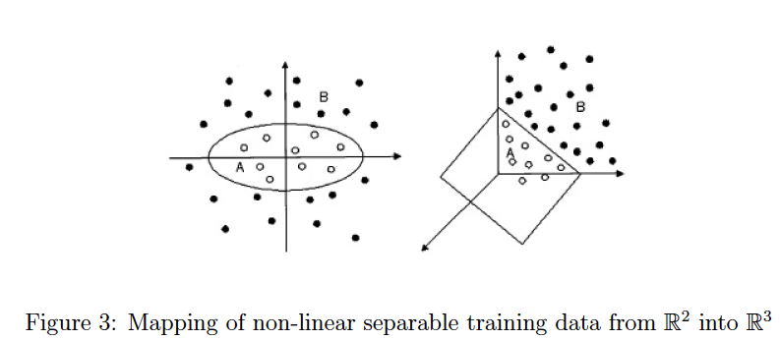
Extending linear models: Non-linear

